Slide 1




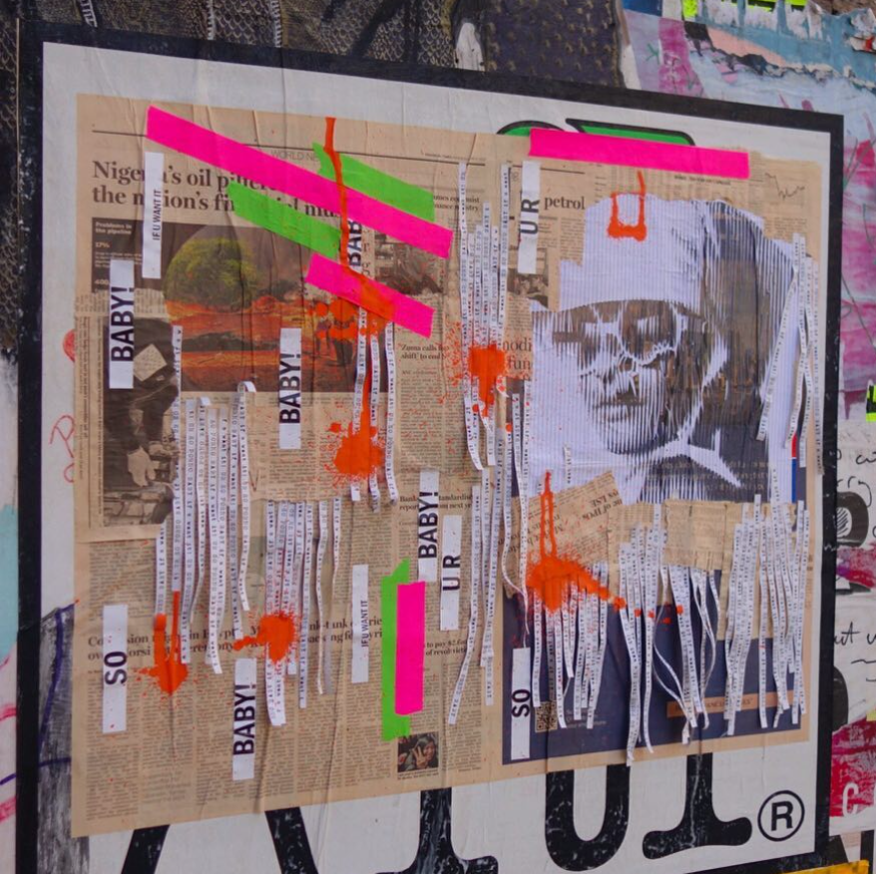

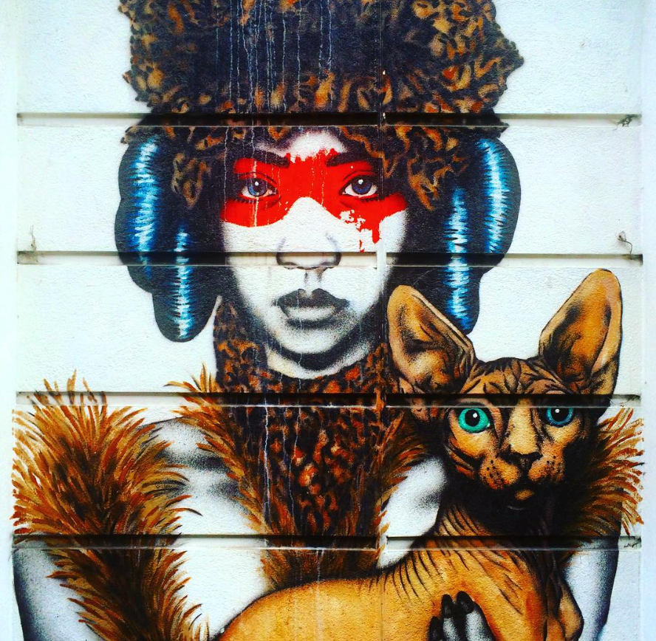
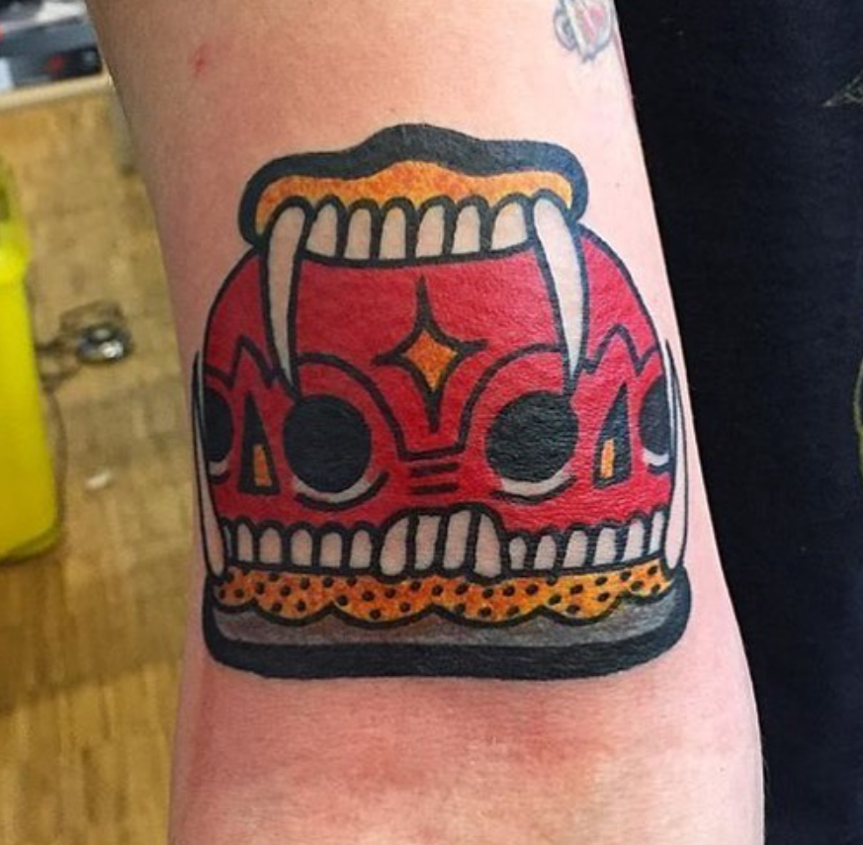
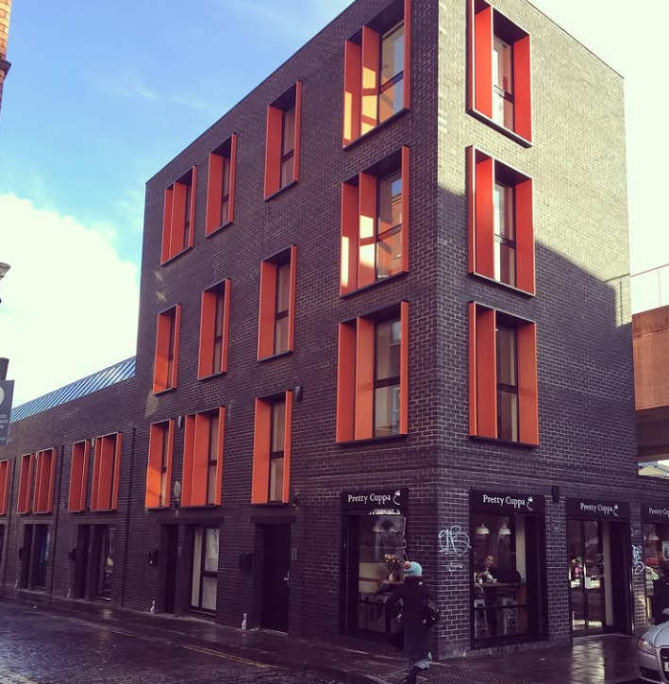
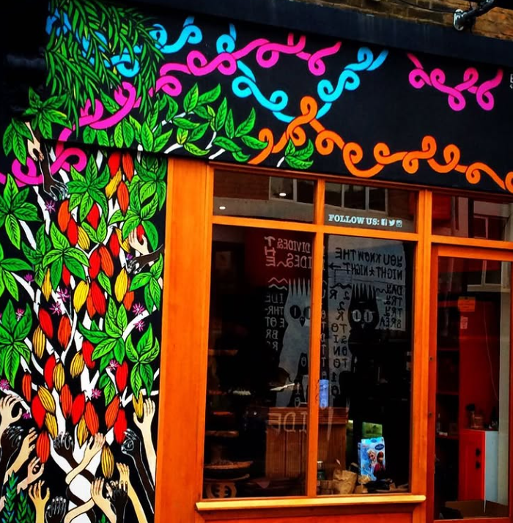
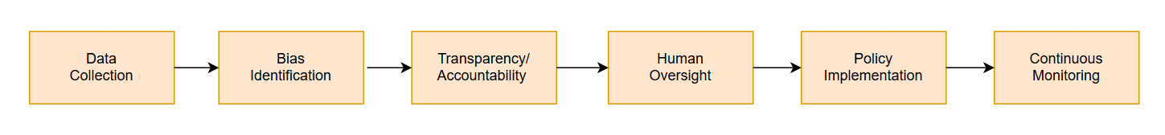
An Ethical and Privacy-focused Analysis of Urban Location-Based Social Media Using Generative AI
Sonali Hornick ^{1,2}, Dhiraj Murthy ^{1,3}
¹ Computational Media Lab, ² McCombs School of Business, ³ Moody College of Communication
Introduction
Project Overview
Results
Introduction
• The rise of generative artificial intelligence (GenAI) in analyzing location-based social media platforms presents new ethical and privacy challenges
• Biases and limitations exist when AI processes diverse cultural expressions (Binns et al., 2018; Noble, 2018).
• Urban social media content provide a culturally diverse environment to ethically investigate AI’s ability to study social media with significant personal metadata
• London's East End has a notable street art scene (Schacter, 2013), unique and diverse fashion culture (Rocamora, 2016), and dynamic urban aesthetics influenced by multicultural interactions (Miles, 2018), making it an ideal case study
• This research employs GenAI techniques to critically analyze Instagram posts from Brick Lane, East London to identify and mitigate inherent biases, examine ethical dilemmas related to AI deployment, explore privacy implications, and establish robust data protection measures
Preliminary insights revealed significant issues in initial AI categorizations:
Street art misclassified as commercial advertising or urban decay
Alternative fashion styles initially labeled inaccurately as subversive or non-mainstream
Upon deeper quantitative analysis:
Overall GenAI misclassification rate: 34% for street art images inaccurately labeled
Significant inaccuracies in fashion categorization: 42% misclassification rate for alternative and subcultural fashion
Spatial accuracy analysis:
Posts within 0.5 km of centroid: 76% accuracy
Accuracy declines sharply to 55% for posts beyond 1 km from centroid
Ethical issues quantified:
Commodification concerns identified in 27% of analyzed visual content
User privacy risks highlighted in approximately 30% of content due to lack of explicit consent
• Marginalization of non-commercial artistic expressions occurred in 40% of analyzed cases
• Approximately 60% of biases originated from commercially skewed training datasets
Research Goals
RQ1 Can Generative AI models successfully classify and interpret visual social media from London's Brick Lane?
RQ2 What biases and limitations are present in GenAI's processing of street art and cultural aesthetics?
RQ3 What are the ethical implications and privacy concerns related to GenAI use in location-based social media analysis?
Future Work
Methods
GenAI significantly shapes visual social media interpretations, with critical implications for cultural representation and user privacy
Persistent biases toward commercial and mainstream aesthetics due to training datasets, impacting cultural representation
Ethical concerns about GenAI-driven misrepresentation of urban cultural identities, potentially distorting authentic local narratives
Privacy vulnerabilities arising from GenAI’s ability to process and potentially misuse personal imagery without explicit user consent, raising concerns about data protection and personal autonomy
Variability in AI accuracy linked to spatial proximity, indicating the significance of location context in enhancing or diminishing model accuracy.
Bias and Ethical Assessment involved
Comparative analysis between GenAI results and human-annotated classifications to detect biases and inaccuracies
Evaluating ethical dimensions, including user consent and privacy risks associated with automated content analysis
The research underscores the necessity of
Developing comprehensive ethical frameworks and transparent privacy standards that guide responsible GenAI use
Incorporating robust accountability mechanisms within GenAI systems to ensure ethical practices and prevent misuse
Advocating for culturally informed, privacy-conscious AI policies that reflect community values and safeguard individual rights
Promoting public awareness and understanding regarding GenAI applications to facilitate informed community engagement.
• Expanding data analysis to include additional global urban cultural centers for comparative insights
• Conducting qualitative research on public perceptions of GenAI-driven cultural analysis and related privacy concerns
• Developing refined ethical guidelines and privacy standards to guide responsible GenAI deployment for studying social media
• Performing longitudinal studies to track the evolution of GenAI biases and ethical issues over time
• Engaging multidisciplinary collaborations with GenAI developers, urban scholars, cultural experts, and policymakers to create inclusive GenAI frameworks
Data Collection
• Curated Instagram posts from January 2018
geotagged from Brick Lane, East London
• Total posts collected: 11,673
• Metadata columns: 23 (visual content, captions, hashtags, engagement metrics, location data, user details)
• Images: 10,533
Data collection via Instagram scraping tools and verified using geolocation tags.
AI Analysis
• Utilized pretrained generative AI models (CLIP, DALL-E) for image classification and visual content interpretation.
• Applied Natural Language Processing (NLP) to analyze textual content in captions and hashtags for thematic context
• Identified the central geographic point (centroid) for Brick Lane at coordinates (51.519938, -0.072529). Then conducted a spatial analysis to evaluate whether the accuracy of AI classifications varied based on how far individual Instagram posts were located from this central point
References
• Binns, R., Veale, M., Van Kleek, M., & Shadbolt, N. (2018). 'It's reducing a human being to a percentage': Perceptions of justice in algorithmic decisions. Proceedings of the 2018 CHI Conference on Human Factors in Computing Systems.
• Miles, M. (2018). Cities and literature. Urban Studies, 55(4), 721-736.
• Noble, S. U. (2018). Algorithms of oppression: How search engines reinforce racism. NYU Press.
• Rocamora, A. (2016). Mediating fashion culture: Digital and urban dimensions. Fashion Theory, 20(4), 505-522.
• Schacter, R. (2013). The world atlas of street art and graffiti. Yale University Press.

